Slide 1
Ridge Regression using PROC REG
A Fixed Effect Model for Determining the Mixture of Acquisition-Subscription Cost
Steven Matthew Anderson
Century Link
Anderson.Research.co.llc@gmail.com

Slide 2
Outline
A Case Study to Introduce Ridge Regression
  Description of the Business Problem
  Regression Model
  Problems with the Model
Ridge Regression Model
  Description of the Method
  How Does it Work
SAS’s PROC REG
  Code
  Output
Simulation of the Model
Summary
Future work

Slide 3
A Case Study to Introduce Ridge Regression
Terminology
  Fixed Cost
  Variable Cost
  Acquisition Expense
  Subscription Expense
  Mixtures of Acquisition and Subscription Expense
  Side Note: Some Examples of Analysis Using this Cost Structure
The Business Problem
The Regression Model
Problems with the Model

Slide 4
Fixed Cost
Fixed costs are business expenses that do not change in proportion to the activity of the business (within a relevant time period)
Discretionary fixed costs
  Arise from annual decisions by management to spend on certain fixed cost items
Committed fixed costs
  Costs that do not change significantly over time
Staff Salaries Network Management Data/IP Strategy Sales Force Management Most Overhead expense

Slide 5
Variable Cost
Variable costs are expenses that change in proportion to the activities of the business.
Semi-variable costs are fixed costs that are adjusted periodically to accommodate changes in business activity.
  Looks like a step function over time
Semi-variable costs are considered in this study to be variable costs.
Costs of goods sold Commissions Sales Headcount (minus commissions) Call Center Staffing Bad Debt

Slide 6
Acquisition Expense
Can be interpreted as expenses incurred to “Make the Sale.”
Positively Correlated with acquisition activities
  # Sales units (Gross Inwards)
  # Call Center employees
Marketing incentives Sales Headcount Installation of Service Design Services (WAN)

Slide 7
Subscription Expense
Can be interpreted as expenses incurred to “Keep the Customer.”
Positively Correlated with Monthly Subscription Activity
  Monthly Revenue
  # of Revenue Generating Units (RGU)
Repair of services Collections Network Monitoring

Slide 8
Mixed Acquisition/Subscription Expense
Expenses that are positively correlated with both Subscription and Acquisition Activity
Fleet
Construction
Hosting Operations

Slide 9
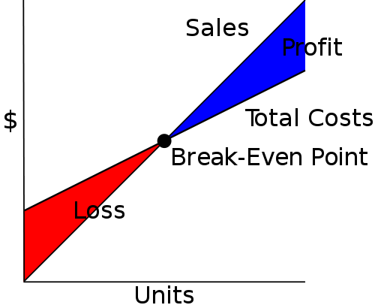
Financial Analysis Examples using this Cost Structure
Break Even Analysis
  Used to analyze the potential profitability of an expenditure in a sales based business
  Need to find the beak-even point (point where revenue is equal to expense)
Picture stolen from Wikipedia

Slide 10
Financial Analysis Examples using this Cost Structure
Customer Lifetime Value
  Used in Marketing to determine how much each customer is “worth” over time
  R=Revenue
  E=Expense
Calculated by:

Slide 11
Description of the Business Problem
Given a particular cost pool (i.e. bucket)
  What percentage of the cost pool can be classified as fixed or variable cost?
  What percentage of the cost pool can be classified as acquisition or subscription cost?

Slide 12
Regression Model
Expense = Total expense in cost pool
A = Acquisition Activity (AGI)
S = Subscription Activity (RGU)
(AS) = Cross Product Interaction Term

Slide 13
Regression Model
100% Subscription Expense
100% Acquisition Expense
Subscription Activity
Subscription Activity
Acquisition Activity
Acquisition Activity

Slide 14
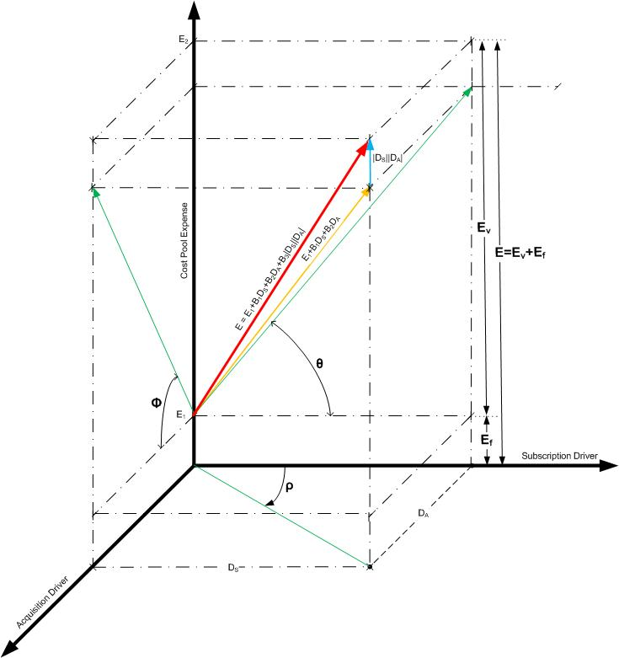
Regression Model

Slide 15
Regression Model
Answering the Fixed/Variable Expense Question

Slide 16
Regression Model
Answering the Acquisition/Subscription Question
E (Total Expense)
S
Acquisition
A
E
Subscription
Percentage of Subscription Cost
Percentage of Acquisition Cost

Slide 17
The Results from My Brilliant Model
Variance Inflation Factors are HUGE!
None of the parameter estimates are significant
When parameter estimates were significant:
  the confidence intervals around them made the results useless!
  The signs were often wrong with respect to reality

Slide 18
The Problem Reading the Log
Extreme Cases
  SAS Note: Model is not full rank. Least-squares solutions for the parameters are not unique. Some statistics will be misleading. A reported DF of 0 or B means that the estimate is biased.
  SAS Note: The following parameters have been set to 0, since the variables are a linear combination of other variables as shown.
  interaction =-105.877 * Intercept + 13.0209 * ln_agi + 8.13133 * ln_rgu

Slide 19
An Example
ods graphics on;
proc reg data=sim_data outvif
outest=bob ;
model total_expense=A S Interaction / tol vif collin;
run;
proc print data=bob;
run;
ods graphics off;

Slide 20
So What Happened?
If (X^{T}X) is invertible, then B has a unique solution B=B*.
Basically for X^{T}X to be invertible each column must be a pivot column. If design matrix X has one or more variables that are linear combinations of the other variables, then when you row reduce X^{T}X you are going to get at least one row that has a bunch of zeros in it, and at least one of your columns isn’t going to be a pivot column. Ergo, you do not have a unique solution!
Near Multicollinearity means that at least one column is approximately a linear combination of some or all of the others, making X^{T}X near singular.

Slide 21
(Enter stage left) Ridge Regression
Modify Least Squares Regression to allow biased estimators of the regression coefficients.
Bias versus precision trade off
Where k≥0 and is known as the biasing or shrinkage parameter
We introduce bias by uniformly
increasing the diagonal elements
and leave the off-diagonal elements
invariant
E(b)
E(b_{R})
Bias of b_{R}

Slide 22
Methods for Picking a Likely Value of k
Graphically using the Ridge Trace Graph – a plot of the parameters against k and estimating where the coefficients become “stable”
Getting the VIF’s as close to 1 as possible
Staring at the errors and figure out where the RMSE levels off
Using the formula by Hoerl, Kennard, and Baldwin

Slide 23
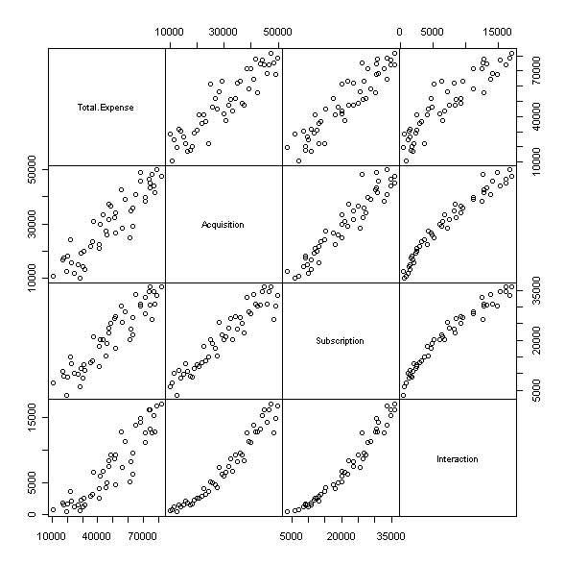
Simulation
50 observations
Intercept=N(1000,50)
Acquisition → N(2500,50)
Subscription = 0.7*Acquisition
Interaction = acquisition*subscription
So “in theory” we should end up with 57% Acquisition and 43% Subscription

Slide 24
SAS’s PROC REG
ods graphics on;
proc reg data=sim_data
outvif
outest=rb
ridge=0 to 0.03 by .001;
title 'Ridge Regression with PROC REG';
model total_expense=A S Interaction / tol vif collin;
run;
ods graphics off;

Slide 25
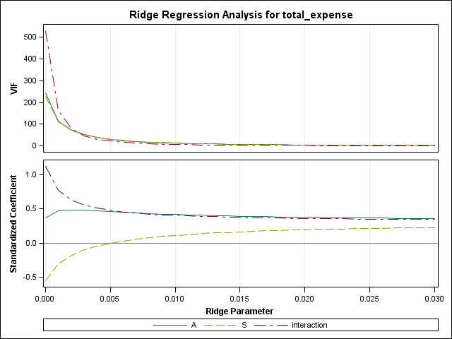
SAS Ridge Plots

Slide 26
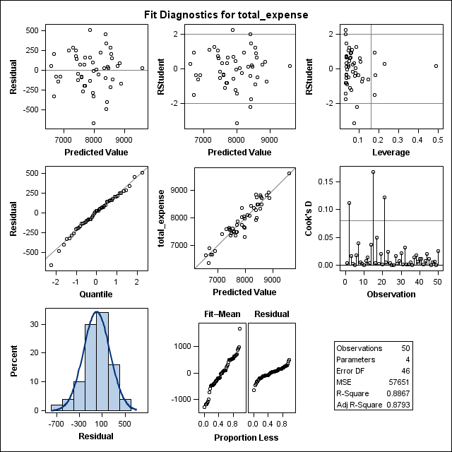
SAS Diagnostics

Slide 27
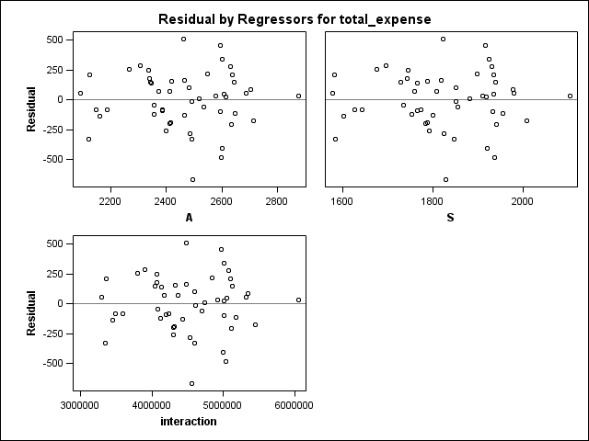
SAS Diagnostics II

Slide 28
SAS Output Dataset
Type of statistics | Ridge regression control value | Root mean squared error | Intercept | A | S | interaction | difference in rmse
PARMS |  | 240.1072 | 4352.4418 | 1.4511 | -3.1776 | 1.28E-03
RIDGE | 0 | 240.1072 | 4352.4418 | 1.4511 | -3.1776 | 1.28E-03
RIDGE | 0.001 | 240.4279 | 2518.0393 | 1.8645 | -1.7268 | 8.74E-04 | 13.3446
RIDGE | 0.009 | 242.0831 | 616.1069 | 1.6862 | 0.5524 | 4.71E-04 | 4.6013
RIDGE | 0.01 | 242.1817 | 565.9577 | 1.6599 | 0.6410 | 4.61E-04 | 4.0718
RIDGE | 0.011 | 242.2697 | 524.0733 | 1.6362 | 0.7175 | 4.52E-04 | 3.6324
RIDGE | 0.012 | 242.3488 | 488.6401 | 1.6147 | 0.7842 | 4.45E-04 | 3.2640
RIDGE | 0.013 | 242.4203 | 458.3412 | 1.5953 | 0.8428 | 4.38E-04 | 2.9523
RIDGE | 0.014 | 242.4855 | 432.1970 | 1.5776 | 0.8948 | 4.33E-04 | 2.6867
RIDGE | 0.015 | 242.5451 | 409.4631 | 1.5615 | 0.9412 | 4.28E-04 | 2.4585
RIDGE | 0.028 | 243.0417 | 268.0123 | 1.4331 | 1.2765 | 3.94E-04 | 1.1248
RIDGE | 0.029 | 243.0680 | 263.2177 | 1.4269 | 1.2911 | 3.92E-04 | 1.0824
RIDGE | 0.03 | 243.0934 | 258.8830 | 1.4211 | 1.3048 | 3.91E-04 | 1.0441

Slide 29
SAS Output Dataset
Ridge regression control value | Type of statistics | A | S | interaction
0 | RIDGEVIF | 244.8223 | 228.4689 | 530.7665
0.001 | RIDGEVIF | 113.7915 | 110.8910 | 164.5080
0.009 | RIDGEVIF | 14.5425 | 14.9128 | 8.0670
0.01 | RIDGEVIF | 12.5768 | 12.9119 | 6.7163
0.011 | RIDGEVIF | 10.9903 | 11.2939 | 5.6825
0.012 | RIDGEVIF | 9.6907 | 9.9662 | 4.8737
0.013 | RIDGEVIF | 8.6122 | 8.8629 | 4.2289
0.014 | RIDGEVIF | 7.7071 | 7.9359 | 3.7067
0.015 | RIDGEVIF | 6.9398 | 7.1492 | 3.2779
0.028 | RIDGEVIF | 2.5530 | 2.6368 | 1.0876
0.029 | RIDGEVIF | 2.4088 | 2.4880 | 1.0239
0.03 | RIDGEVIF | 2.2770 | 2.3519 | 0.9663

Slide 30
Simulation Results
Model: (57% Subscription, 43%Acquistion)
  Expense =1,000+(Acquisition)+(Subscription)+(Interaction)
OLS: (184.1% Subscription, -84.1%Acquistion)
  Expense = 4352.442– 1.4511(Acquisition) –
  3.1776(Subscription) + (1.28E-03)(Interaction)
SAS Ridge: (67.3% Subscription, 32.7%Acquistion)
Expense = 488.64 + 1.61(Acquisition) + 0.784(Subscription) + 3.624(Interaction)

Slide 31
Summary
Ridge Regression corrects for multicollinearity problems by modifying the method of least squares to allow more precise biased estimators.
Allows me to perform Customer Lifetime Value and Breakeven Analysis with existing correlated regressors
Not perfect but better than OLS Estimation
SAS needs some additional functionality
  Confidence intervals for B_{i}’s
  Confidence intervals for k

Slide 32
Next Steps
Implementing other methodology for choosing shrinkage parameter
    Dorugade and Kashid (2009)
    Mardikyan and Cetin (2008)
    Lawless and Wang (kLW) (1976)
Add to SAS
  Confidence Intervals
    Firinguetti & Bobadilla’s Asymptotic Confidence Intervals
    Crivelli, Firinguetti & Montano’s Boot Strapping Confidence Intervals
    Feig’s Monte Carlo method for Evaluating Confidence Intervals

